Slide 1
Climate Vulnerability Analysis
Seasonal Drought
New Lebanon
Climate Smart Communities
Task Force
December 29, 2020

Slide 2
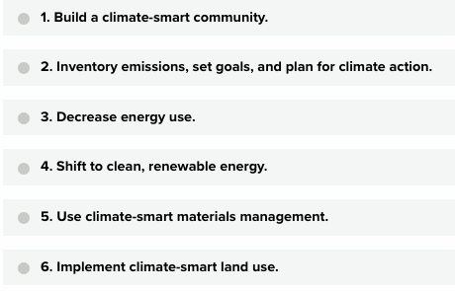
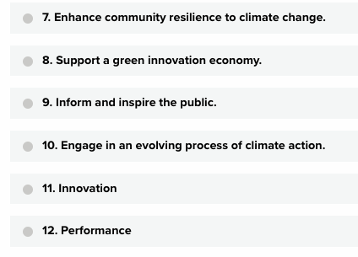
Climate Smart Categories

Slide 3
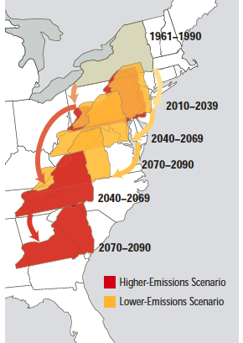
Possible climate hazards for New Lebanon
Storms (winter, summer, ice, wind, hurricanes, tornados)
Flooding
Heat Stress
Seasonal Drought
Invasive Species
Wildfire
Based on a review of climate projections from New York State, Massachusetts, NOAA, and other scientific analyses
Union of Concerned Scientists (2007)

Slide 4
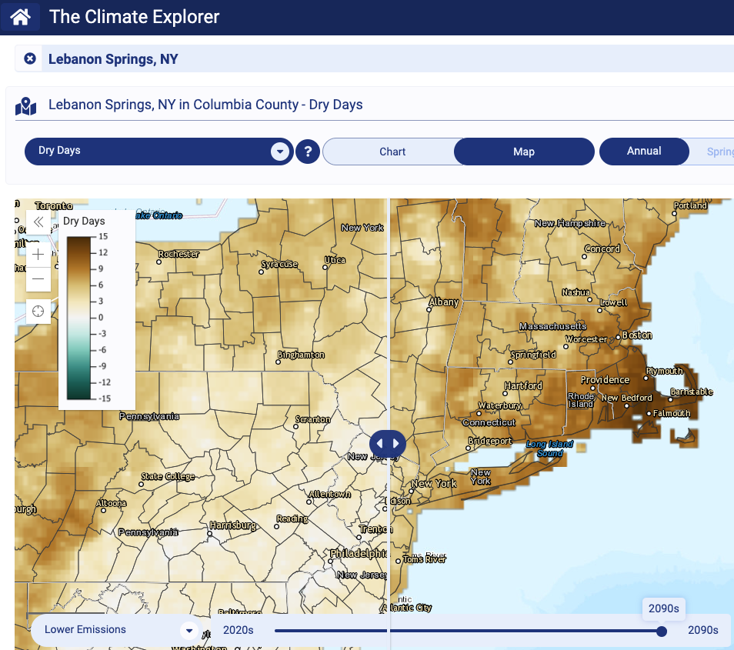
Drought analysis for New Lebanon
Extrapolating regional climate projections down to town level
From 2020-2100 possible to see 15-18 extra consecutive dry days (under high emissions scenario).
This would translate roughly into an extra consecutive dry day every 5 years
Lower emissions scenarios would be less severe
NOAA Climate Explorer

Slide 5
Possible impacts of longer seasonal drought
Possible impacts
More frequent dry wells
Crop damage
Impact on ecosystem
Increase in wildfire risk

Slide 6
Next steps
Continued community engagement
Assess and prioritize other hazards
Use prioritization to help inform:
  CSC resilience planning
  Town Emergency Management plan
  Columbia County Hazard Mitigation plan
Climate Smart Communities Task Force Contact
Marc Anthonisen
mja45@cornell.edu

